Slide 1
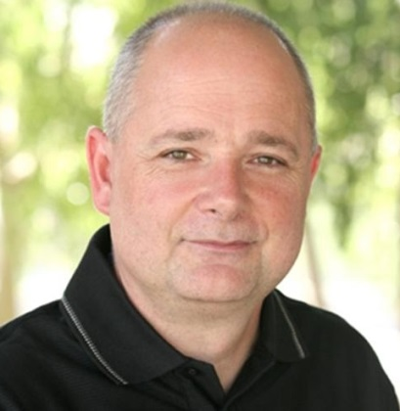
Lasting Behavior Change Achieve positive behavior change in yourself and others
Making change that sticks
Virtual Meeting
Mark Clare
New Value Streams Consulting
mark.k.clare@gmail.com
260-433-7923
Your host

Slide 2
The Promise
Goal
Specifics
Learn to apply a reliable process for making behavior change that sticks in yourself and others.
Straight forward to use
Inexpensive
Grounded in science
Based on proven practice
Works on all challenges with the exception of those involving clinical or mental health disorders
LBC = Lasting Behavior Change

Slide 3
Example Behavior Change Challenges Personal and Professional
Weight
Stress
Exercise
Money
Health
Relationships
Sleep
Self Improvement
Teacher
Engage students and avoid disruptive classroom behaviors
Manager
Motivate employees to try new ways of working
Doctor
Coach patients to make health behavior changes
Parent
Get kids to listen, take responsible actions and learn

Slide 4
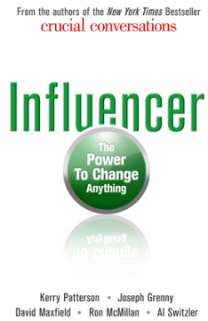
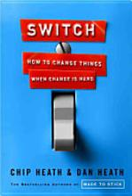
Approach Distill the Lessons Learned from the Latest Science
Target simple but vital behaviors
Motivate change by appealing to both heart and mind but mostly heart
People automatically adapt to changes in the environment so change the environment
People change people so look to networks, groups, friends and family members
Behavior change is an experimental process of learning from experience.

Slide 5
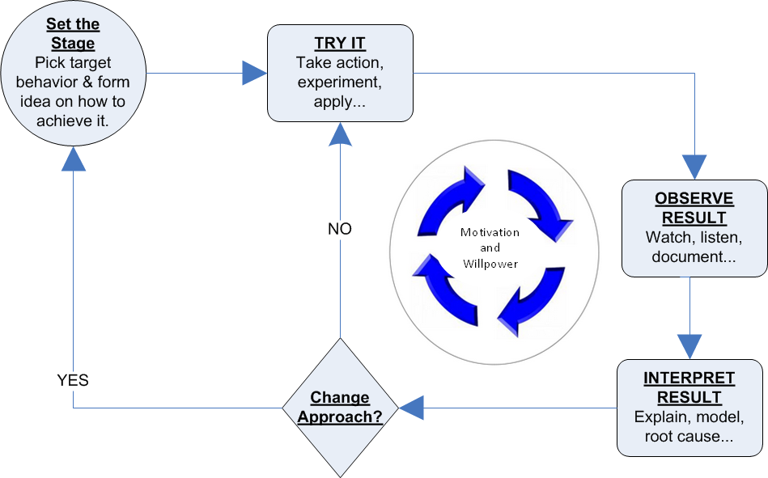
Approach Define a process for applying the lessons to everyday situations
Learning from experience is the flywheel for behavior change

Slide 6
1. Target Simple Vital Behaviors 2. Motivate From the Heart 3. Change Environment 4. Work Through Others 5. Systematically Experiment
Lesson One

Slide 7
Target Simple Vital Behaviors
Break your improvement goal into simple behaviors
Easy to confuse behaviors with outcomes or tasks
Need to specify behaviors to stop, start and avoid starting
Translate target behaviors into small steps that lead toward your goal
Behaviors?
Speak clearly
Collaborate
Lose 20 lbs.
Get the mail
Have empathy
Don’t text and drive
"A goal properly set is halfway reached.“ Zig Ziglar

Slide 8
Target Simple Vital Behaviors
To find simple behaviors use the 3-hows or ask how can I do that 3 times in a row
Start: Be more empathetic
How can I do that?
HOW1: Listen carefully when someone is speaking
How can I do that?
HOW2: Focus on what they are saying
How can I do that?
HOW3: Watch their face and take notes
Two simple behaviors!

Slide 9
Target Simple Vital Behaviors
Vital behaviors are those that are most important for achieving the change goal
Practiced by the best and not by lesser performers
Quick research then through your own experience
What behaviors are vital for providing good customer service? How about losing weight?

Slide 10
Target Simple Vital Behaviors
Stop Doing X
Old habit to unlearn
Start Doing Y
New habit to learn
Avoid Starting Z
Unwanted compensating behaviors
Work arounds
New bad habits
Habits are behaviors we do automatically. Learning new habits is how we make behavior change stick

Slide 11
Take Small Steps to Get Started Continue to define smaller and smaller steps until you are motivated to act
Personal
Professional
Goal: Lose weight
Behavior to start: Eat reduced portions of high calorie foods
Small step: Order small rather than large fry
Smaller step: Leave two fries in the box
Behavior to avoid starting: Having sugary snack mid-afternoon
Goal: Employee empathy
Behavior to start: listen during emotional outburst
Small step: Assume customer has right to be angry
Smaller step: Recall a time when you received similar service and got mad
Behavior to avoid starting: Getting angry or bad mouthing the organization
Smaller steps require less effort & motivation

Slide 12
Guidelines
Use 3-hows to get to specific behavior
Make steps smaller and smaller until there is clear motivation for doing it
Look to what others have discovered
Quick research
Ask people that have made the change
Is this the fastest way I can get started?
Label behaviors and small steps in a meaningful way
Play to your strengths
Formulate behavior to try as if then rule
Search iTunes or the App store for NewHabits or use link below
https://itunes.apple.com/us/app/new-habits/id604403553?mt=8

Slide 13
Practice
Pick an improvement goal
Use the 3-hows to find a simple behavior
Define one small step you are motivated to take
Try it out!
Consider labeling or play to your strength in step three

Slide 14
1. Target Simple Vital Behaviors 2. Motivate Change by Appealing to Both Heart and Mind but Mostly Heart 3. Change Environment 4. Work Through Others 5. Systematically Experiments
Lesson Two

Slide 15
We are of Two Minds
The Rider
The Elephant
Rational
Conscious
Cool
Emotional
Automatic
Hot
Watchful, thinking, and self controlled.
In the moment, runs on gut, powerful & impulsive.
“Learning how to train the elephant is the secret of self-improvement.”

Slide 16
The Logic of the Heart
You don’t train the elephant with reason but with the logic of the heart
Follow the feel-goods
Protect and expand sense of identity
Seek pleasure avoid pain
Emphasize immediate gains over future gains
100+ cognitive biases that reveal details of automatic thinking

Slide 17
The Logic of the Heart
To uncover the logic of the heart use the 3-Whys or ask why three times in a row
Why don’t I/they already practice the target behavior?
Why don’t you exercise regularly every week?
WHY1: I don’t have the time
Why don’t you have the time?
WHY2: I am busy with work and family
Why are you busy with work and family?
WHY3: They are more important than exercise
Emphasize immediate over future.

Slide 18
Define Small Steps Using the Logic of the Heart
Use the 3-Why to understand what is standing in the way of starting or stopping the target behavior and define small steps to work around it.
Define small steps that:
Avoid pain and create pleasure or some feel-good
Leverage pride, values and personal stature
Provide immediate rewards but also generate long-term benefits
You likely won’t figure the elephant out right away so keep notes on the Whys and the small steps you try out and how well they work
Examples
Take a walk with family after dinner
Set a 10,000 step goal with peers at work

Slide 19
Don’t Forget The Rider
Sometimes lack of skill or lack of confidence to gain a skill blocks behavior change
I don’t know how to do that
I won’t be able to do that
Trying that is too risky in my environment
Identify skills and techniques needed to enact the vital behaviors
Quick research
Observe people that have made the change
Take small steps to practice techniques
Behaviors change when we satisfy both the elephant and the rider. The rider demands a clear meaningful goal and the belief that they have or can acquire the skills needed to reach the goal.

Slide 20
Guidelines
If behaviors are not changing it is a skill (rider) or motivation (elephant) issue
Positive affirmations work
Link change goals directly to:
Values
Moral imperative or ethical issues
Larger purpose
Fun or pleasurable
Personalize consequences of inaction
Create a positive penalty for inaction
Examine self talk about change
List fears and other emotions that are blocking action
https://itunes.apple.com/us/app/new-habits/id604403553?mt=8

Slide 21
Practice
Pick an improvement goal
Use the 3-hows to find a simple behavior
Use the 3-whys to determine why the behaviors are not already practiced
Focus on a motivation issue
Use the logic of the heart to define one or more small steps to enact the behavior
Try them out!
The Logic of the Heart
Follow the feel-goods
Protect and expand sense of identity
Seek pleasure avoid pain
Emphasize immediate gains over future gains

Slide 22
1. Target Simple Vital Behaviors 2. Motivate From the Heart 3. People Automatically Adapt to Changes in the Environment so Change the Environment 4. Work Through Others 5. Systematically Experiment
Lesson Three

Slide 23
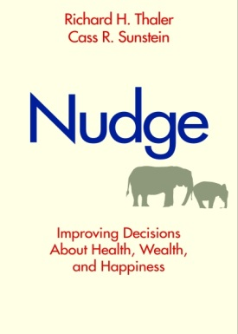
Change the Environment
Small changes to the environment can be a quick and easy way to produce big and lasting behavior changes
School cafeteria
An order wheel
Disposable latex gloves
100+ cognitive biases that reveal details of automatic thinking
The elephant takes it cues from the environment. Change the cues and retrain the elephant.

Slide 24
Change Environment
Identify enablers and defeaters
Enablers makes it easy to enact the new behaviors
Defeaters makes it hard to enact the new behaviors
Generate ideas to strengthen enablers and weaken defeaters
Hard stops make it impossible to do things in the old way
Nudges promote the new behavior but leaves options open
How do I change the environment to promote new behaviors and block unwanted behaviors?

Slide 25
Example: Weight Loss
Defeater: See treats every time you enter kitchen
Nudge
Move treats out of site
Hard stop
Dispose of treats and don’t buy more
Enabler: More water less soda
Nudge
Put plenty of water in your fridge and push soda to the back
Hard stop
Stock only water
This works for personal change and when you want to influence behavior change in others.

Slide 26
Guidelines
Move things around, get rid of things that trigger old habits, buy things that promote new behaviors
Set defaults to support new behaviors
Use notes, reminders, alarms and other forms of information
Reduce steps and time it takes to start new behavior
Keep score and reward yourself BUT not by indulging in the behavior you want to stop
https://itunes.apple.com/us/app/new-habits/id604403553?mt=8

Slide 27
Practice
Pick an improvement goal
Use the 3-hows to find a simple behavior
Identify one defeater and one enabler
Define a way to weaken the defeater & strengthen the enabler
Implement them!
Enablers make it easier to start the new behaviors and defeaters make it hard.
Consider both a nudge and a hard stop in step four.

Slide 28
1. Target Simple Vital Behaviors 2. Motivate From the Heart 3. Change Environment 4. People Change People so Look to Networks, Groups, Friends & Family Members 5. Systematically Experiment
Lesson Four

Slide 29
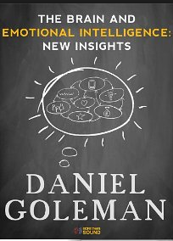
Social by Nature
Brain is hardwired to be part of group
Strong psychological need to be included, respected, loved and needed
Strongly influenced by the individuals and groups we associate with
Behavioral mimicry
“The most fundamental discovery of this new science: We are wired to connect..”
Daniel Goleman

Slide 30
Method
Identify individuals and groups that
will naturally support the change
may tend to resist or even sabotage the change
Define ways to link with supporters and manage detractors
Identify moments of truth and how to get help
Turn detractors into supporters
Determine if new relationships are necessary to achieve change goal
Change support groups
Professional help
Often simplified into the principle of peer pressure, the idea is you can influence behavior
change in people through other people that have influence with them.

Slide 31
Example – Kids and Physical Activity
Supporters
Teachers, active students at school
Potential detractors
Sedentary friends, sedentary family members
Moment of truth
Hanging out with sedentary friends after school
Manage potential detractors
Buy Wii and host a play session with sedentary gamer friends
This approach includes both working with others and change the environment.

Slide 32
Guidelines
Make a promise to someone important
Announce change goal publically
Look to others that have already achieved the goal
Get a sponsor
Find an online community
Form informal support group
https://itunes.apple.com/us/app/new-habits/id604403553?mt=8

Slide 33
Practice
Pick an improvement goal
Use the 3-hows to find a simple behavior
Identify support and potential detractor relationships
Define a way to manage detractors & get help from supporters
Implement them!
Supporters provide motivation, energy and advice for reaching the change goal
Detractors discourage or even work again progress towards the change goal

Slide 34
1. Target Simple Vital Behaviors 2. Motivate From the Heart 3. Change Environment 4. Work Through Others 5. Behavior Change is an Experimental Process of Learning From Experience
Lesson Five

Slide 35
Learning Agenda
Target simple but vital behaviors
Behaviors to stop, start and avoid to reach the change goal?
Motivate change by appealing to both heart and mind but mostly heart
How to leverage the logic of the heart?
What skills are need to enact the new behaviors?
People automatically adapt to changes in the environment so change the environment
How to leverage enablers and manage defeaters?
People change people so look to networks, groups, friends and family members
How to leverage supporters and manage detractors?
The first four lesson tell us what we need to learn to create lasting behavior change.
The fifth lesson tell us we need to take a systematic and persistent approach to learning what works for us.

Slide 36
Learn From Experience A four-step process that repeats until we find techniques that work and stick
Learning from experience is the flywheel for behavior change

Slide 37
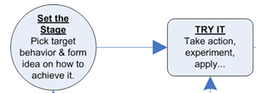
Set the Stage and GO!
Start with behavior that is clearly linked to the change goal
Pick a technique for making the change that is proven to work
Start with a small step that you or others are motivated to take
Take a few minutes in the morning to identify times you can try the small step during the day
Pick something interesting or with little risk
Set a reminder to try it

Slide 38
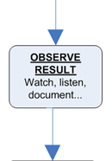
Observe the Results
Use all your senses
Make measurements
Read body language
Capture the data but also your thoughts and feelings
Document or record the results just after experience
Want to sharpen your observation skills?
https://itunes.apple.com/us/app/new-habits/id604403553?mt=8

Slide 39
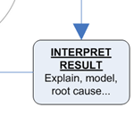
Interpret the Results
Did it work?
Don’t over generalize based on one measurement or experience
Think in terms of cause and effect
Get to root cause using 3-whys
Special reasons or causes
Want to sharpen your interpretation skills?
https://itunes.apple.com/us/app/new-habits/id604403553?mt=8

Slide 40
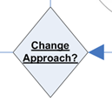
Change Approach?
If it worked do you need to keep doing it to form a habit?
If it did not work do you need to try:
It again under different circumstances?
Refinements or modest adjustments?
New technique?
New target behavior?
Be conservative and try a given technique/behavior several times before making changes
When you do fail and decide to change approach be sure you have a solid reason
If you decide to change approach go back to set the stage
This is a critical decision! Don’t be too quick to change your approach. We are trying to learn from experience and that can take several spins of the fly wheel

Slide 41
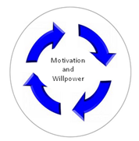
Staying the Course
Failed attempts reveal what to try next
Get something out of every try
Small steps add up to significant change over time
Take time to manage motivation and willpower
Want to boost motivation and willpower?
https://itunes.apple.com/us/app/new-habits/id604403553?mt=8

Slide 42
Learn From Experience A four-step process that repeats until we find techniques that work and stick
Click for larger version
Learning from experience is the flywheel for behavior change

Slide 43
Change Goal = Weight Loss
NO

Slide 44
Guidelines
Break a big change goal down into specific behaviors and small steps
Learn from others – do quick research and talk to others that have successfully made change
Take a deliberate approach to learning from experience and actively observe and interpret
Document findings and ideas. Take pictures and keep a journal
Try things daily or regularly and in a variety of circumstances
Make sure you gain insights, have fun and earn points along the way
Get better at learning from experience by sharpening the underlying skills
https://itunes.apple.com/us/app/new-habits/id604403553?mt=8

Slide 45
Practice
Pick a change goal
Set the stage
Complete three cycles through the process
Document your results
What’s next?
This is your opportunity to apply all five lessons learned to make real change. Use the document Behavior Change Pathway to guide your work.

